Slide 1
E-Procurement Project
Going Paperless at SU
Approving Purchase Requests

Slide 2
When To Use a Purchase Requisition vs. a Check Request
Purchase Requisition
Check Request
Services that involve a contract with multiple payments
Placing an order for goods/ merchandise when we will be invoiced in the future after receipt of order.
Anything computer related (hardware/ software)
Event registrations, especially if a deposit is needed
Conference registrations when there is an option for a PO
Services that involve a contract with one time payment
Magazine/newspaper subscriptions
Membership renewals
Orders that require prepayment in full.
** This process does not currently apply to blanket PO’s

Slide 3
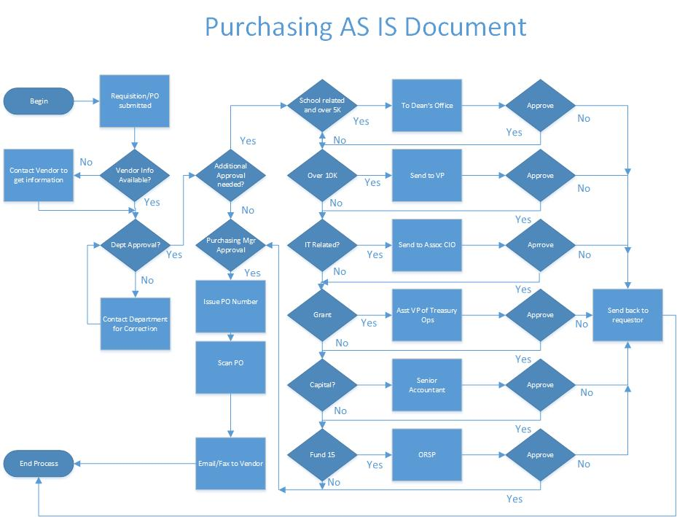
Paper Forms
Routed Via Interoffice Mail

Slide 4
No Paper!
Workflow utilizes Email and Web Req to provide updates and reminders

Slide 5
Benefits to iNow Approval Process
Faster routing of purchase request
Required approvals obtained prior to Purchasing Services receiving request
Reduced errors in budget numbers
Improved tracking of purchase requests within the approval process
Reduced paper consumption

Slide 6
Approval Requested Notification
You will receive an email informing you that a purchase request is in your queue that needs attention.
Note, if you are responsible for more than one queue, the queue name will be in the email along with a link to WebNow that will bring directly to that que.

Slide 7
Signing into WebNow (the client for iNow)
PC Users can ONLY Internet Explorer
http://srv-voyager:8080/webnow
Mac users can only use Safari and may need to use this link
http://srv-voyager.adm.suffolk.edu:8080/webnow/index.jsp
If you have any issues signing into WebNow, send an email to ImageNow@Suffolk.edu. There is no need to include the help desk as this will record your ticket automatically.

Slide 8
Signing into WebNow
Click Don’t Block if this appears. This may appear each time you log in.

Slide 9
Signing into WebNow (cont.)
Log on with your active directory/email login ID and password.

Slide 10
Navigating WebNow
If you used the link in the notification email, you will be brought directly to the queue referenced in the email.
Double click the item to be approved

Slide 11
Reviewing Request Documents
The first time you open a requisition, you will need to set the default view. This only needs to be done on your first requisition. That first time, the screen will look like this ->
This is the confirmation email the requestor received and then forwarded to iNow to start the approval flow.

Slide 12
Reviewing Request Documents (cont.)
You will need to view the properties as this is where you approve the document.
Click View then Properties and Thumbnails. Thumbnails is where you would see the additional backup for the request. This will set your default view so you’ll only need to do it once.

Slide 13
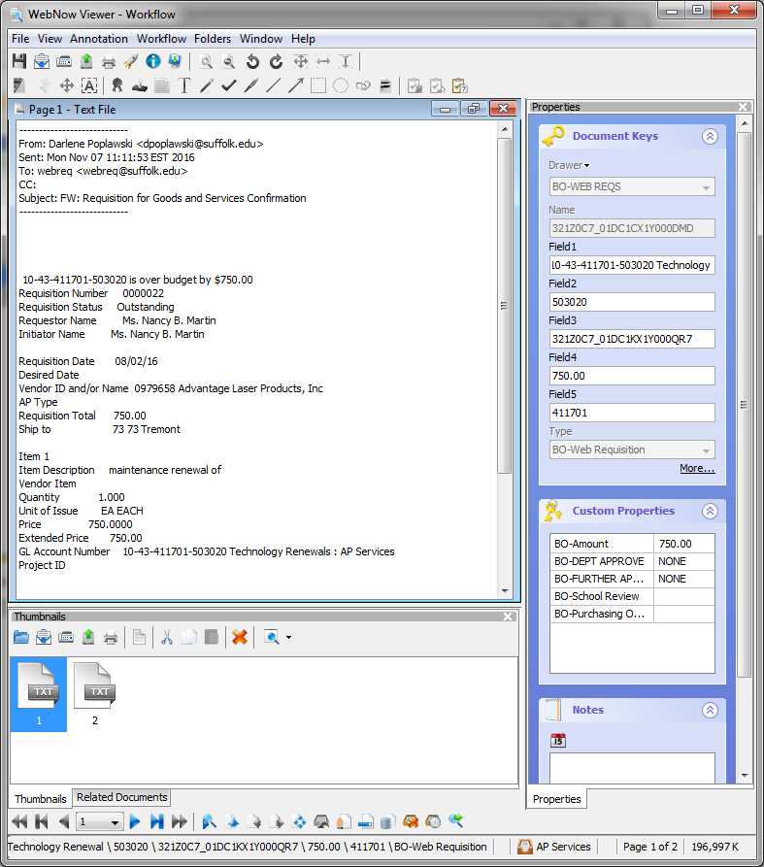
Reviewing Request Documents (cont.)
Note the panel on the right and the thumbnails on the bottom. If you don’t see the thumbnails on the bottom, drag the bottom up to reveal the thumbnails.

Slide 14
Approving Purchase Requisitions
Here is an example of the properties shown for a requisition. iNow uses these fields to properly route the request for approvals.
You will approve the request in the Custom Properties section.

Slide 15
Approving Purchase Requisitions (cont.)
If you are approving as a department manager or department head, click in the box next to the down arrow next to Dept Approver. If you only see NONE as an option, click in the box, not the down arrow.
If you wish to approve the request, choose APPROVED.
If you choose not to approve, there is an option of NOT APPROVED. You will need to let the requestor know as they are not automatically notified.
Do not make changes to the BO-Amount field.
FURTHER APPROVE, School Review, and REVIEW are for additional layers of approval.

Slide 16
Approving Purchase Requisitions (cont.)
If you are an approver for additional conditions (i.e., ITS, Grant, Dean, etc.) choose the drop down from BO-Further Approver. You will have the same option of NOT APPROVED. Again, you will need to contact the requestor as they are not automatically notified.

Slide 17
Approving Purchase Requisitions (cont.)
After you have approved or not approved, click on the calendar icon under Notes. This will populate with your ID and the date. You may add a note as well. This is very important as it acts as your signature.

Slide 18
Approving Purchase Requisitions (cont.)
From the menu click File then Save or click on the disc icon located under the word “File” in the menu and you are done. iNow will route the request forward.

Slide 19
Navigating WebNow
If you sign into Web Now directly vs. using the link the email, your first screen will look like this.
If you are an approver for only one queue, you can set it up so you will be brought directly into that queue. However if you use the link in the email, this isn’t necessary.
Click on options. Then click on Explorer Options.

Slide 20
Navigating WebNow (cont.)
Click Toolbar on the left hand side. Then using the drop down under Workflow choose your one queue. Lastly under Initial State, change the dropdown next to Action to Workflow default.
If you are an approver on more than one queue, leave Workflow set to None. If you predominately use one queue, you may set it as a default.

Slide 21
Navigating your Queues
When you log in, you will be in your workflow queue and any items you have to approve will be listed.

Slide 22
Navigating your Queues (cont.)
If you are an approver of more than one queue, you may select the queue from the dropdown shown here.

Slide 23
What if I’m not on Campus
If you use a PC or Mac off campus and have a desktop PC on campus, you may access Web Now using the University’s VPN. If you are not already familiar with this process, contact ITS.
If you use a Mac laptop that you carry back and forth, you may use a program named Junos Pulse to access the University’s network. Contact ITS to set this up for you.
There is not currently a mobile option for Web Now.

Slide 24
Last Step
Remember to sign out of Web Now when you are finished.

