Slide 1
E-Procurement Project
Going Paperless at SU
Processing purchase requests

Slide 2
When To Use a Purchase Requisition vs. a Check Request
Purchase Requisition
Check Request
Services that involve a contract with multiple payments
Placing an order for goods/ merchandise when we will be invoiced in the future after receipt of order.
Anything computer related (hardware/ software)
Event registrations, especially if a deposit is needed
Conference registrations when there is an option for a PO
Services that involve a contract with one time payment
Magazine/newspaper subscriptions
Membership renewals
Orders that require prepayment in full.
**This process does not currently apply to blanket POs

Slide 3
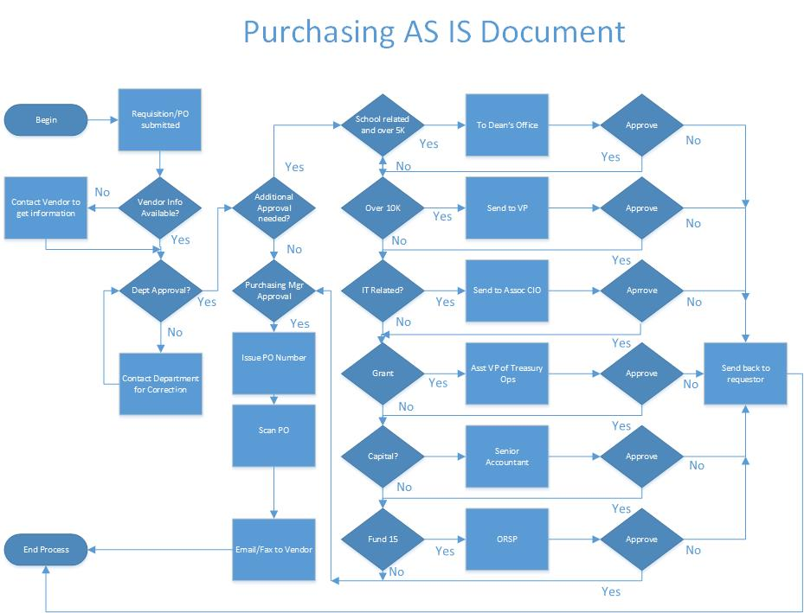
Paper Forms
Routed Via Interoffice Mail

Slide 4
No Paper!
Workflow utilizes Email and Web Req to provide updates and reminders

Slide 5
Entering a Purchase Requisition
PC users, use Internet Explorer (not Chrome or Firefox) go to the Web Advisor web-site. Mac users may use Safari (click Continue if a warning about the certificate appears).
Log in using your Network ID. The password your first initial (in Caps) last initial (lowercase) from your Network ID then your 7 digit colleague ID (the one on your school photo ID). For example John Smith would be Js1234567.
https://waprod.suffolk.edu/WebAdvisor/WebAdvisor?TYPE=M&PID=CORE-WBMAIN&TOKENIDX=9915489674
(make sure to book mark this link once you’ve opened it)

Slide 6
Entering a Purchase Requisition (cont.)
Choose Employees from the titles on the right.

Slide 7
Entering a Purchase Requisition (cont.)
Choose Enter a Requisition for Goods or Services. (NOTE: This process must be completed in one session. There is no “Save” feature.)

Slide 8
Entering a Purchase Requisition (cont.)
Enter the vendor name and click Submit. Do not choose “I do not wish to perform a Vendor Lookup”.
Enter as little and as much of the vendor name so the search results will show you the vendor you are searching for without giving you too many results. For example, do not type only the word “Advanced” as many vendors names begin with that word. Rather type in Advanced Imaging. Use only full words, there are no wildcards.
If you are searching for a person, type first name first then last name or just the last name.
If the vendor you are looking for is not in the results, it will probably need to be set up as a new vendor first. Give the vendor information to a member of the Purchasing Services Department and they will let you know when the vendor is available for you to continue.

Slide 9
Entering a Purchase Requisition (cont.)
Click the radio button next to the desired vendor and Submit.

Slide 10
Entering a Purchase Requisition (cont.)
Note: some searches results will show multiple choices for what appears to be the same vendor. If this occurs (see the three to the right all with the 10 Huntington Ave address), contact the Purchasing Services Department to confirm which vendor should be selected.

Slide 11
Entering a Purchase Requisition (cont.)
You will notice your ID and email have populated the Initiator and Confirmation E-mail Address fields. Ignore the warning about falling beyond the current fiscal year

Slide 12
Entering a Purchase Requisition (cont.)
Enter the ship to from a drop down menu. The majority of the time this will be 73 Tremont for offices located in that building and 8 Ashburton for all others. For large or multiple box deliveries, consult the Purchasing Services Department.

Slide 13
Entering a Purchase Requisition (cont.)
Complete the fields as such:
Item Description - If you have a quote, enter that here rather than a list of items. You will have the opportunity to add supporting documentation. Remember to include shipping costs.
Quantity - If services enter 1. If goods all at the same unit price, you can enter the qty.
Do not use the Vendor Item field, rather put the item number in the Item Description field.

Slide 14
Entering a Purchase Requisition (cont.)
(cont.)
Unit of issue - Choose EA-Each
Price - This is the unit price. If you entered a quantity of 10 and a Price of $100, the total amount of the requisition will be $1,000.

Slide 15
Entering a Purchase Requisition (cont.)
(cont.)
Cost Center – This is the first two segments of your budget line item.
Object Code – This is the last two segments of your budget line item.
Users will only have access to budget lines within their department. Invalid budget line number prevents users to proceed to next step

Slide 16
Entering a Purchase Requisition (cont.)
Note, the routing rules of your purchase requisition for approval within Image Now is based on the first Budget Number (GL number) of your requisition. Therefore any line is to be charged to a fund other than fund 10, it is important to enter that item first in the requisition. For example if you were ordering items to be charged to fund 15 as well as fund 10, enter the fund 15 item first.

Slide 17
Entering a Purchase Requisition (cont.)
Printed Comments – These are instructions to be printed on the purchase order. This is where you would enter a contact name and email at the vendor that the purchase order should be sent to.
Instructions for Purchasing Department –any specific instructions for the Purchasing Department relating to the order.
Click Submit.

Slide 18
Entering a Purchase Requisition (cont.)
If the combination of Cost Center and Object Code are not valid, an error message will appear near the top of the screen. The budget number will need to be corrected before you can continue. You may correct it from this screen and click on Submit again.

Slide 19
Entering a Purchase Requisition (cont.)
This screen will show you your requisition details and the requisition number.

Slide 20
Starting the Approval Process in iNow
After you have successfully submitted the requisition through Web Advisor, you will receive an email from Datatel User ID. Forward this email with any documents that relate to your purchase request (i.e., quotes, related emails, etc.) as attachments to the email to webreq@Suffolk.edu . The attachments must be in .pdf form. Do not type any text into the email. Image Now (iNow) will forward the request automatically for further approvals per the approval guidelines in the Payment & Procurement Authorization Policy. (If you don’t receive this email within 5 minutes, check your junk folder in Outlook. If it’s not there check with the Purchasing Services.)
NOTE: Only use Outlook or Umail.Suffolk.edu for this process. Do NOT use an email client on an Apple computer.

Slide 21
Now What?
At this point your requisition is being routed systemically through the necessary approvals. You do not need to do anything! The required approvers are notified automatically of the pending requisition needing their approval (reminders will be sent daily until approved).
If you would like to know where your request is in the process, contact the Purchasing Services Department. They can look it up for you.
After all other approvals have been obtained, the document(s) will be routed to Purchasing Services for review and Purchase Order creation.
If an approver chooses to not approve your request, there is no systemic notification. The approver should contact you. In most instances, if changes need to be made to the requisition, contact the Purchasing Services Department for assistance as they will be able to make the changes and reroute the documents for approval within iNow.

Slide 22
What is My PO#?
You may use Web Advisor to lookup the PO# on your requisition.
Log into Web Advisor. Under Requisitions choose PO Review.

Slide 23
What is My PO# (cont.)?
Note in this example, some requisitions have Purchase Order numbers and some do not. Those without numbers do not have purchase orders created yet.
If you click on the PO#, this will open a .pdf of your purchase order if you would like a copy.

Slide 24
Completed Purchase Order

Slide 25
Last Step
Remember to sign out of Web Advisor when you are finished.
Do not sit idle on the system as your session will time out.

