Slide 1
Leveraging Technology to Increase Learning Through Student-Feedback Tools Leveraging Technology to Increase Learning Through Student-Feedback Tools
Facilitated by:
Mitchell Wolf, Instructional Technologist, ITS
and Linda Bruenjes, Director, CTSE

Slide 2
Feedback from formative, summative and authentic assignments can:
Enable diverse learners to understand
How well they are doing
Where they need to improve
How they can become self-directed learners
Enable instructors to
Assess student learning
Enhance student learning
Take many forms
Individualized feedback
Group feedback
Peer feedback
Self-assessment

Slide 3
Goal
Upon successful completion of this session, participants will:
understand that frequent opportunities for feedback not only fosters student learning but can be offered through tools that can potentially mitigate the increased workload associated with additional learning activities and assessments.

Slide 4
Learning Objectives
During this session, participants will:
Link assessment strategies with research on how learning works
Identify ways to foster learning through performance feedback
Link teaching/learning strategies with feedback tools
Match learning objectives with teaching strategies and technology tools
Develop a plan to learn how to use chosen feedback tools

Slide 5
WARMUP EXERCISE
Learning

Slide 6
ACTIVITY 1
Prior Knowledge

Slide 7
Directions for polling
Take our your phones
Send a message to the 5-digit number
In the body of the message, you will type (key word)
You will receive a confirmation message that you are now part of the session.
From here on, you will reply with a letter response
37607
MPW2424

Slide 8
Notes:
To what extent do you use Blackboard?
https://www.polleverywhere.com/multiple_choice_polls/Uqbsg0z3be42G1B

Slide 9
Notes:
I understand the difference between formative and summative assessments
https://www.polleverywhere.com/multiple_choice_polls/DhIzvy1AL00nv9x

Slide 10
Notes:
I use rubrics for course assignments
https://www.polleverywhere.com/multiple_choice_polls/6SLCYiZ9opsrmOx

Slide 11
Notes:
I feel comfortable experimenting with academic technologies such as polling software, etc.
https://www.polleverywhere.com/multiple_choice_polls/p6yKexYMD5cQgD2

Slide 12
Notes:
I know where to get assistance for using academic technologies
https://www.polleverywhere.com/multiple_choice_polls/QsZY4xunkQdaRio

Slide 13
Feedback to Activity 1
To develop mastery, students must:
Acquire component skills
Practice the skills
Know when to apply the skills they have just learned
Students who do not have the appropriate amount of practice will have a hard time meeting challenges.
How do we address the wide variety of preparedness in our classes?
Individually
Group
Self

Slide 14
Feedback to Activity 1 - Technology
Glossary

Slide 15
Feedback to Activity 1 – Technology
JOURNAL
Rubrics are used for. . . . Formative assessments contribute to student learning . . . .

Slide 16
Feedback to Activity 1 - Technology
Short Tutorial
Kahn Academy
YouTube
Panopto

Slide 17
Feedback to Activity 1 - Technology
Announcement

Slide 18
To develop mastery, students must: -Acquire component skills -Practice the skills -Know when to apply the skills they have just learned Students who do not have the appropriate amount of practice will have a hard time meeting challenges
 | Teaching/Learning Strategy | Technology Tool
Scaffold Learning | Group work | Online discussions
Individualized Learning | Build necessary vocabulary | Glossary, Journal, Quiz/Tests
Short Tutorials | Review previously learned materials | Panopto to create a tutorial; YouTube to link to a prepared tutorial; KahnAcademy to practice a skill
Communication | To share information after or before class | Announcement, discussion forum

Slide 19
ACTIVITY 2
Students who are not practiced enough to meet a challenge on their own may benefit from working with other students in pairs or small groups (Vygotsky’s Zone of Proximal Development – scaffolding) Ambrose, et al, 2010, p. 132.

Slide 20
Practice is what students do to learn. Research cited in How Learning Works suggests that 3 ingredients, when added together, foster learning and performance. (Ambrose, p. 127)
Practice that is:
P1 Targeted towards an appropriate challenge level
P2 Focused on a specific goal or criterion for performance
P3 Sufficient enough to meet performance criteria
ACTIVITY 3
Ingredient(s) | Strategy | Tool(s) | How it Fosters Learning
P1 | Assess prior knowledge
P2 | Be explicit about learning goals
P2 | Communicate performance criteria
P1, P3 | Build in multiple opportunities for practice
P1, P3 | Build scaffolding into a larger assignment
P2 | Look for patterns of errors in student work
P2 | Respond to class as a whole
Technology Tools: Survey, Quiz, Documents, Assignment, Rubric, Discussion Forum, Journals, Videos, Podcasts, Announcements, Poll

Slide 21
What do we know about feedback?
More effective when
Identifies particular aspects of student performance
Specific feedback is linked to deeper learning
Too much feedback can be ineffective
Students need to do something with the feedback
Timing of feedback (when and how often)
A balance
Students need to have space to monitor their own progress

Slide 22
Activity 4 – How do we mitigate time needed for increased feedback?
LO#3 – Link teaching/learning strategies with feedback tools

Slide 23
Activity 5: Identify time-saving tools that facilitate feedback
Tool(s) | Feedback (I, G, W)* | Notes | ✓
Survey
Quiz
Glossary
Announcement
Discussion Forum
Assignment
Rubric
Journal
Podcast
Video
Collaborate

Slide 24
Discussion Forum

Slide 25
Assignment

Slide 26
EXAMPLE RUBRIC

Slide 27
GRADING WITH A RUBRIC

Slide 28
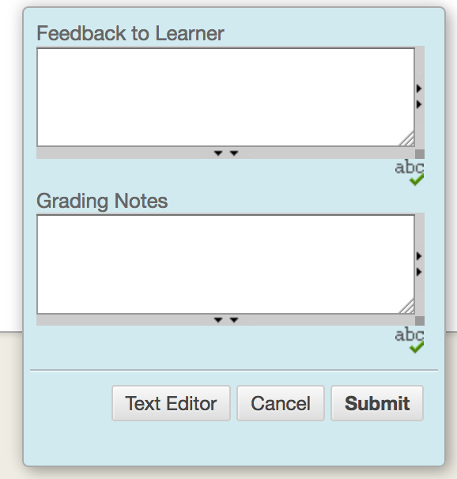
Quick Comment to Anything Graded

Slide 29
Videos

Slide 30
Collaborate (synchronous web meeting)

Slide 31
Activity 6: Course Map LO#4 Match learning objectives with teaching strategies and technology tools
Week | Teaching Strategies | Feedback | Reason | Teaching/ Learning Goal | Student response to feedback | Tool | Need to learn
1 | Prior knowledge inventory | Whole group | To challenge students | Determine who needs more practice | Complete prework | Polleverywhere
 | 1’ paper | Whole group | To acknowledge what they have learned and what they do not know | Review | In class discussion | Announcement or video tutorial | How to use Panopto
2 | Outline of paper | Individual | To develop ideas | Target feedback on writing process | Student rewrite | Rubric/Assignment | Rubric, assignment
3 | Develop list of resources | Self- assessment; and Individual | To improve self-efficacy | Target feedback on information literacy | Student edits | Rubric/ asignments
4
5
6 | Midterm Feedback | Whole group | To take the temperature of the class | Give students a voice; gauge responsibility | Journal entry - metacogniton | Survey | Qualtrics
7
8
9
10 | Create rubric for presentation | Group | To establish guidelines | To scaffold learning | To come up with a common rubric | Discussion Forum | Discussion Forum for groups
11
12
13
14 | Final Presentation | Self, Peer, Group, Individual | To take and give constructive criticism | To gauge effectiveness of final project | Self and Peer | Rubric, Assignment, CATME | CATME

Slide 32
Resources for using LMS LO#5 – Develop a plan to learn how to use chosen feedback tools
ITS Instructional Technology
Blackboard Tutorials
One-on-one Support: Email servicedesk@suffolk.edu
Teaching and Learning with Technology – CTSE@suffolk.edu

