Slide 1
2019-20 Jessup International Law Moot Court Team
Info Session
April 26, 2019

Slide 2
What is Jessup?
Largest moot court competition with 680 schools in 100 countries
Unique network of Jessup participants globally
Based on a fictional problem involving a dispute between two countries before the International Court of Justice (judicial organ of U.N.)
Named after Phillip C. Jessup - international law scholar, diplomat, ICJ judge

Slide 3
What is the Jessup team timeline?
Early September: Applications due, interviews
Mid September: Problem released
Mid September – Mid January: Work on researching and writing briefs (“memorials”); meet bi-weekly with faculty advisors
Mid January: Memorials due
Mid January – Mid February: Prepare for oral argument (3x/week including a weekend morning)
Mid February: Travel to NYC for Northeast Regional Qualifying Round
April: Int’l Round in DC for finalists of Qualifying Rounds

Slide 4
How many members are on the team?
Four members: Two will represent Applicant, the other two Respondent
  Research and write memorials
  Do oral argument
Possible fifth member to serve as “Of Counsel”
  Attends all team meetings
  Helps with memorials, oral argument prep
  No oral argument, but sits at counsel table

Slide 5
Who should apply?
Coursework in International Law or
strong interest and desire to learn;
Strong written and oral advocacy skills;
Willingness to commit substantial time;
Ability to function as part of a team;
Ability to work over winter break to finalize memorials

Slide 6
What is the application process?
The Call for Applications will occur in late August or early September
Required materials
  Cover letter
  Resume
  Transcript
  Writing Sample
  LPS oral argument recording, if available
Interviews

Slide 7

2018-19: The Case Concerning the Kayleff Yak

Slide 8
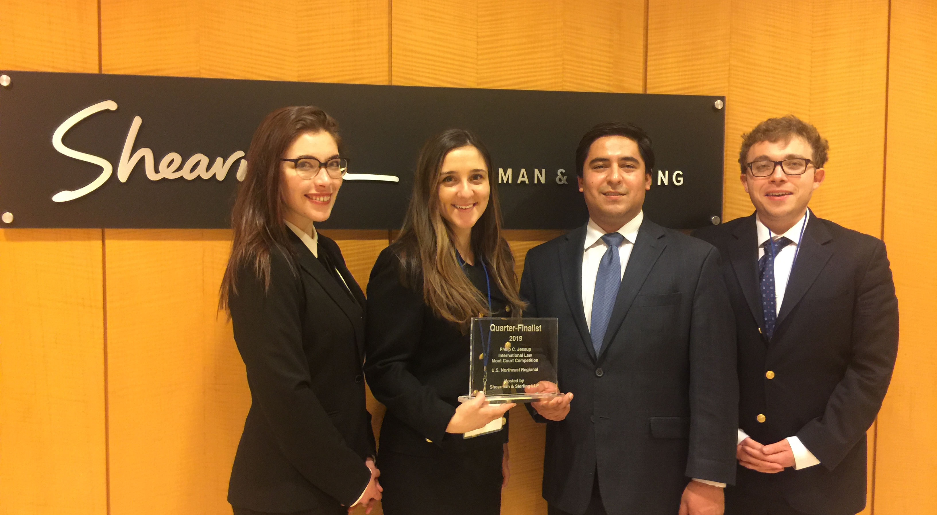
2018-19 Team - Quarterfinalists

Slide 9
2019-20 Jessup Problem
multi-fora international litigation;
responsibilities of heads of state for war crimes;
killer robots; and
a wall.

Slide 10
For further information
www.ilsa.org
Email Prof. Kim: rkim@suffolk.edu

